Slide 1

Sentiment analysis of Book Summaries using NLP Group 5
Team members :
Shraddha Surve
Bhuvaneshwaran G
Shreyas K chudi
Kunal Shelke
Poonam Yadav
Mentors: Karthik /dhanya

Slide 2
Business problem and business objective
Business Problem:
Extract Summary of any E-Book and perform sentimental analysis with an model accuracy of 75%
Business Objective:
To extract E-books of your choice and extract summary ,categorize summary as positive, negative or neutral. Build a NLP model to achieve the said objective with accepted accuracy of 75% and above.

Slide 3
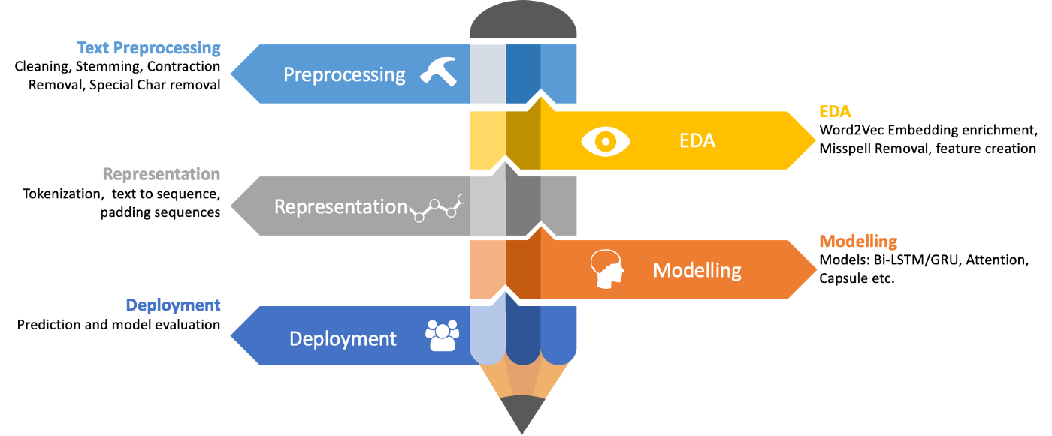
Project Architecture and Project flow

Slide 4
Data Extraction:
We have taken Book summary data from https://www.goodreads.com/
We have use Octoparse web scraping tool for data extraction
Steps followed for data extraction:
Go to the web page
Create A pagination
Build a loop Item
Extract the data
Run the task and get the data

Slide 5
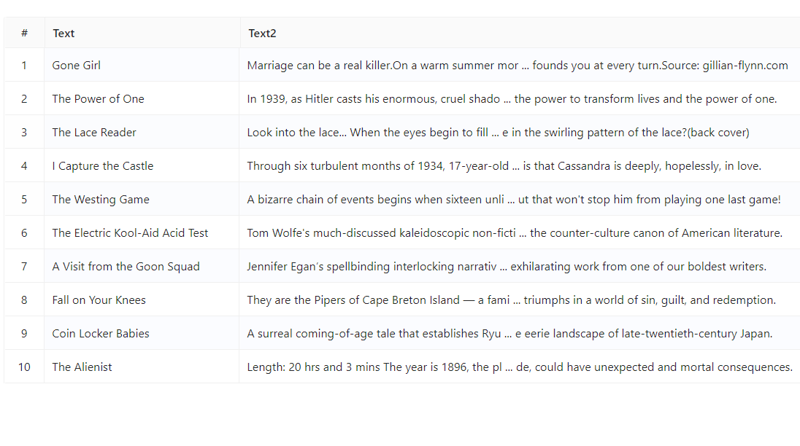
Extracted data from Octoparse

Slide 6
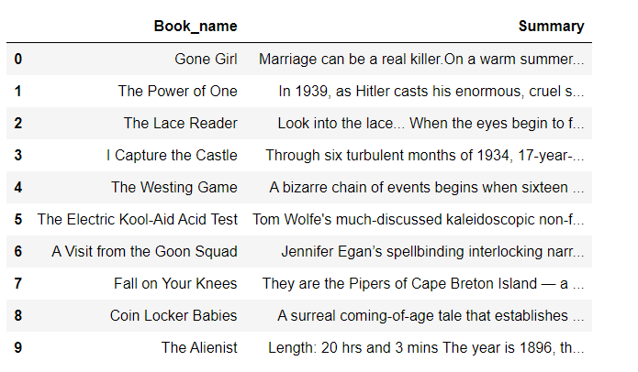
Dataset Details:
We have extracted 10 books name and there summary

Slide 7
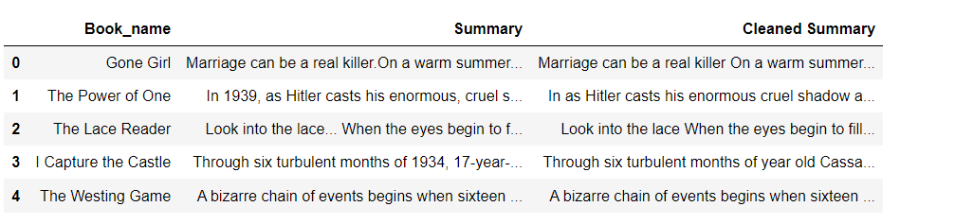
EDA
Step 1: Data Cleaning
-- In this process we have removed all the special and numerical characters from the summary
-- The output we have got is cleaned summary

Slide 8
EDA
Step 2: Tokenization
Tokenization is breaking the raw text into small chunks. Tokenization breaks the raw text into words, sentences called tokens. These tokens help in understanding the context or developing the model for the NLP. The tokenization helps in interpreting the meaning of the text by analyzing the sequence of the words.

Slide 9
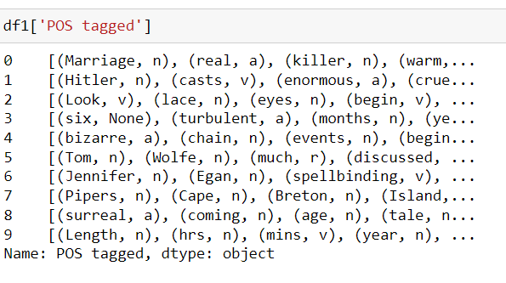
EDA
Step 3: Enrichment – POS tagging
It is a process of converting a sentence to forms – list of words, list of tuples (where each tuple is having a form (word, tag)). The tag in case of is a part-of-speech tag, and signifies whether the word is a noun, adjective, verb, and so on.

Slide 10
EDA
Step 4: Stop words removal
Stop words are a set of commonly used words in a language. Examples of stop words in English are “a”, “the”, “is”, “are” and etc. Stop words are commonly used in Text Mining and Natural Language Processing (NLP) to eliminate words that are so commonly used that they carry very little useful information.

Slide 11
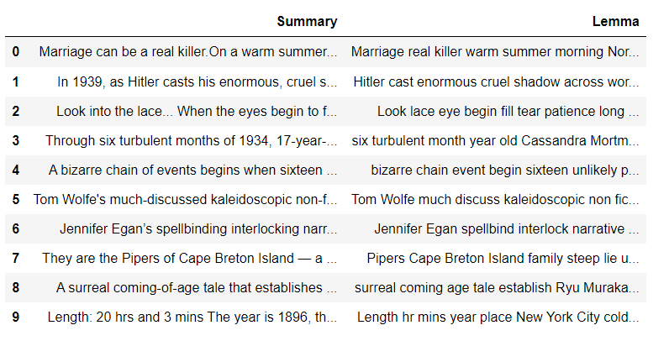
EDA
Step 5: Obtaining the stem words
A stem is a part of a word responsible for its lexical meaning. The two popular techniques of obtaining the root/stem words are Stemming and Lemmatization.
The key difference is Stemming often gives some meaningless root words as it simply chops off some characters in the end. Lemmatization gives meaningful root words, however, it requires POS tags of the words.

Slide 12
Wordcloud
A word cloud (also known as a tag cloud) is a visual representation of words. Cloud creators are used to highlight popular words and phrases based on frequency and relevance

Slide 13
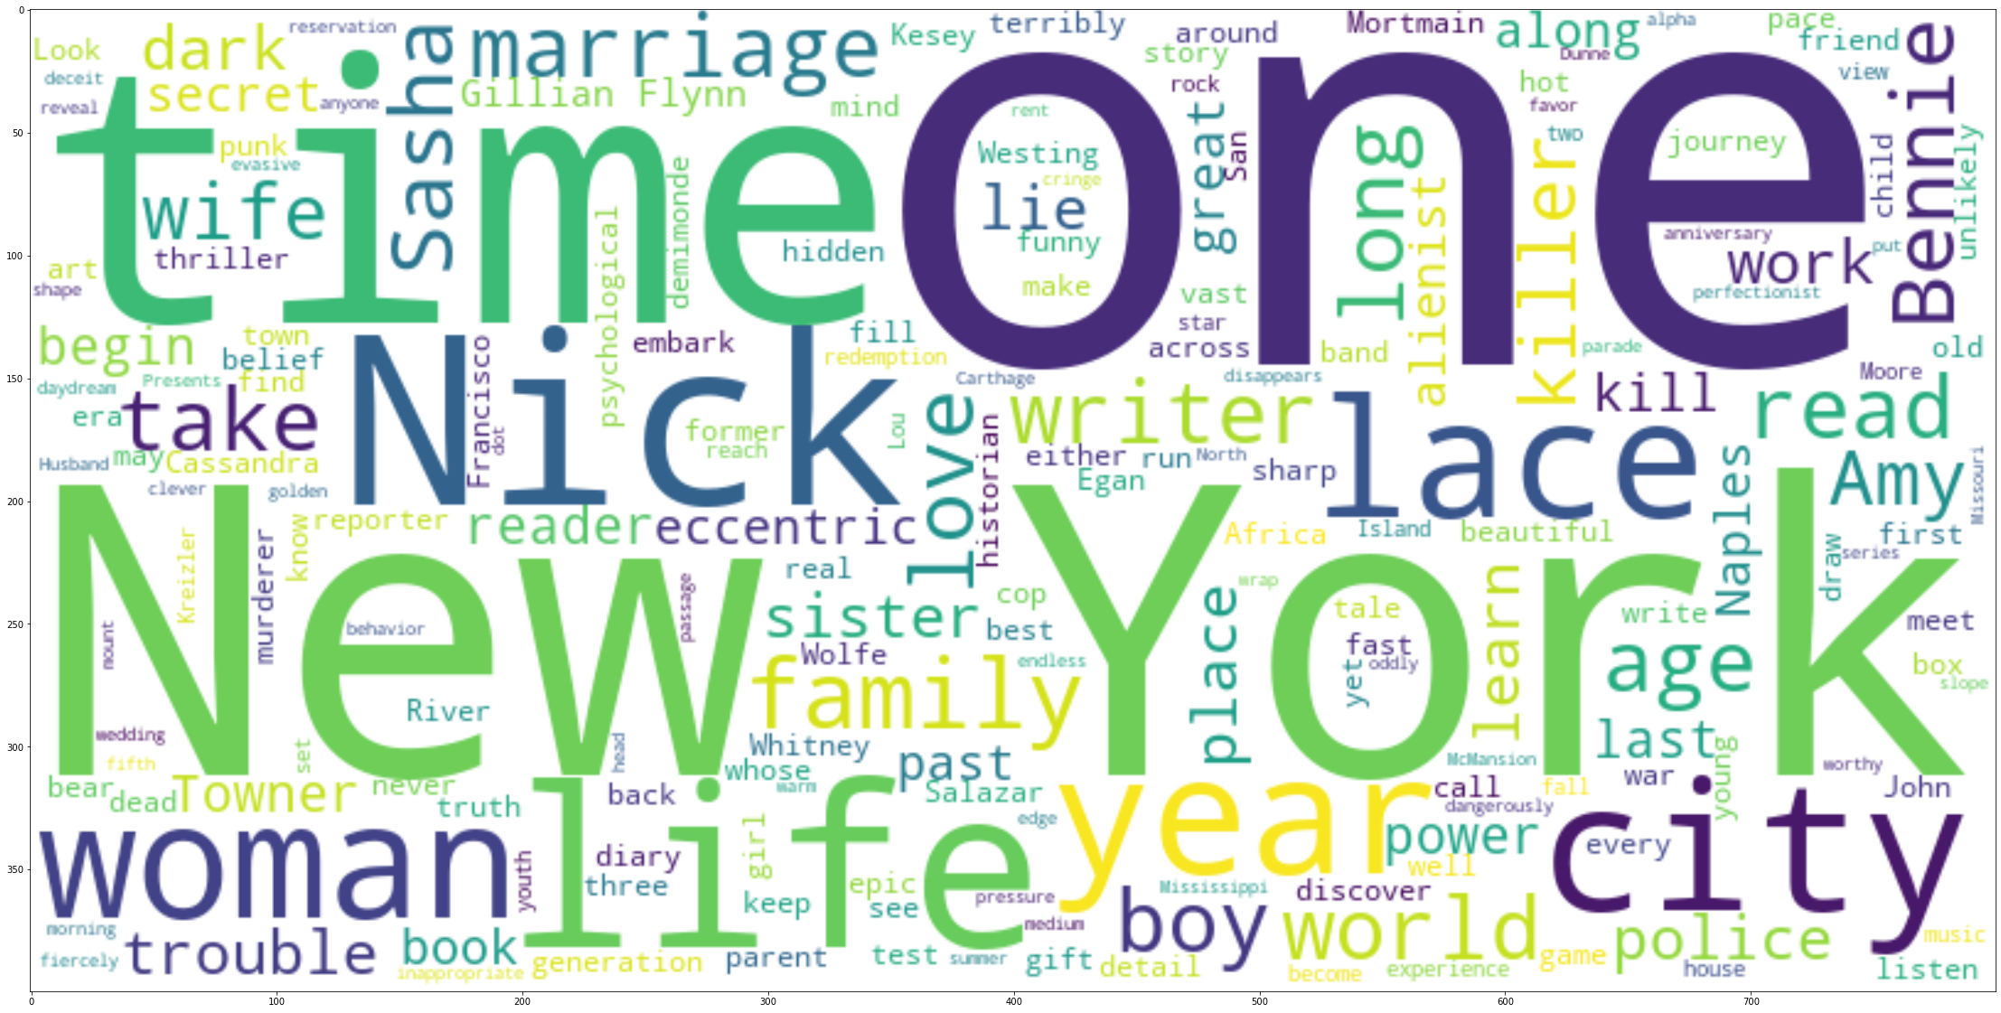
Wordcloud for whole summary

Slide 14
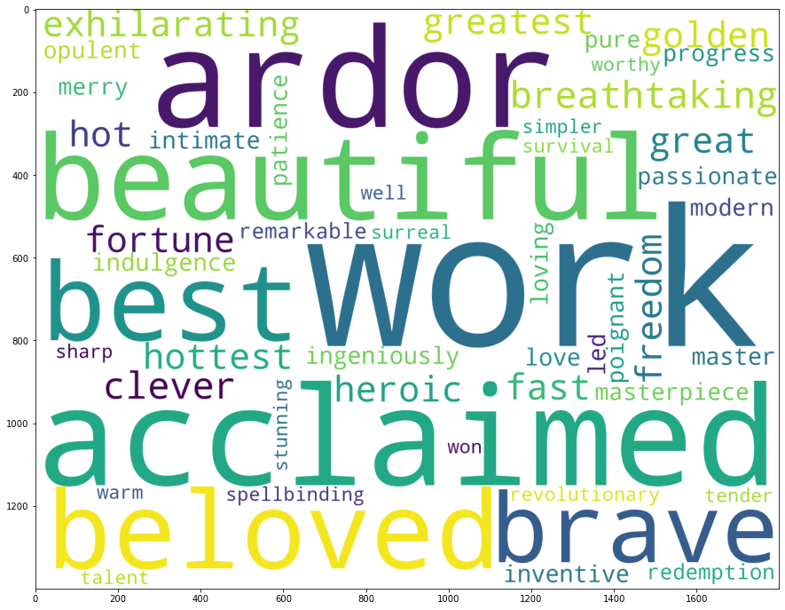
Wordcloud for positive words in summary

Slide 15
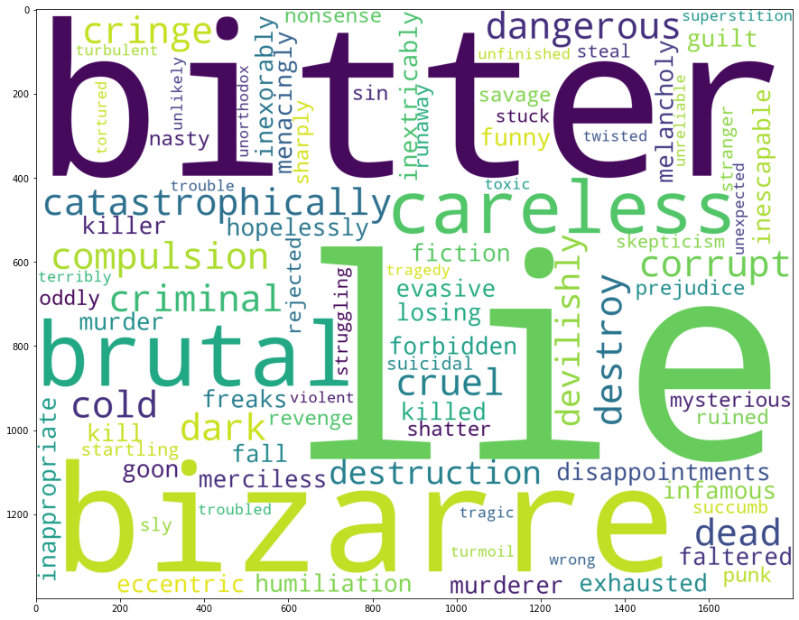
Wordcloud for Negative words in summary

Slide 16
Model Building (Textblob)
1) Sentiment Analysis using TextBlob:
TextBlob is a Python library for processing textual data. It provides a consistent API for diving into common natural language processing (NLP) tasks such as part-of-speech tagging, noun phrase extraction, sentiment analysis, and more.
The two measures that are used to analyze the sentiment are:
Polarity – talks about how positive or negative the opinion is Subjectivity – talks about how subjective the opinion is TextBlob(text).sentiment gives us the Polarity, Subjectivity values. Polarity ranges from -1 to 1 (1 is more positive, 0 is neutral, -1 is more negative) Subjectivity ranges from 0 to 1(0 being very objective and 1 being very subjective)

Slide 17
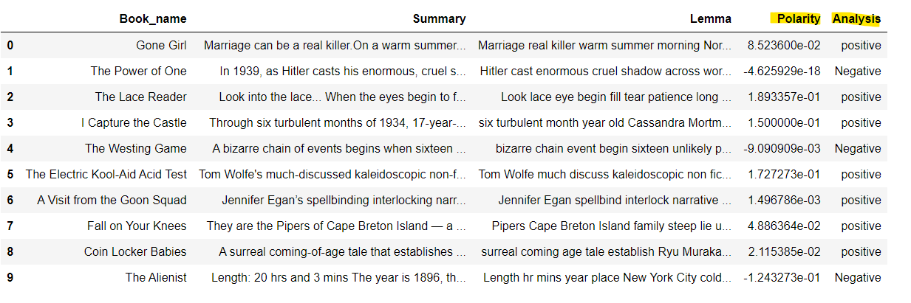
Output of TextBlob

Slide 18
Model Building (VADER)
2)Sentiment analysis using VADER
VADER Sentiment Analysis. VADER (Valence Aware Dictionary and Sentiment Reasoner) is a lexicon and rule-based sentiment analysis tool that is specifically attuned to sentiments expressed in social media, and works well on texts from other domains
The sum of pos, neg, neu intensities give 1. Compound ranges from -1 to 1 and is the metric used to draw the overall sentiment.
positive if compound >= 0.5
neutral if -0.5 < compound < 0.5
negative if -0.5 >= compound

Slide 19
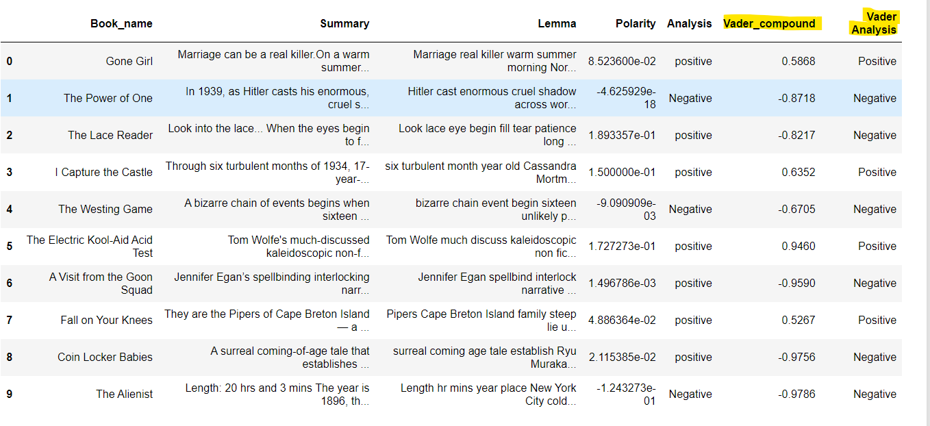
Output of VADER

Slide 20
Model DePLoyment
We have used streamlit for model deployment
We have choosen VADER model for deployment part

Slide 21
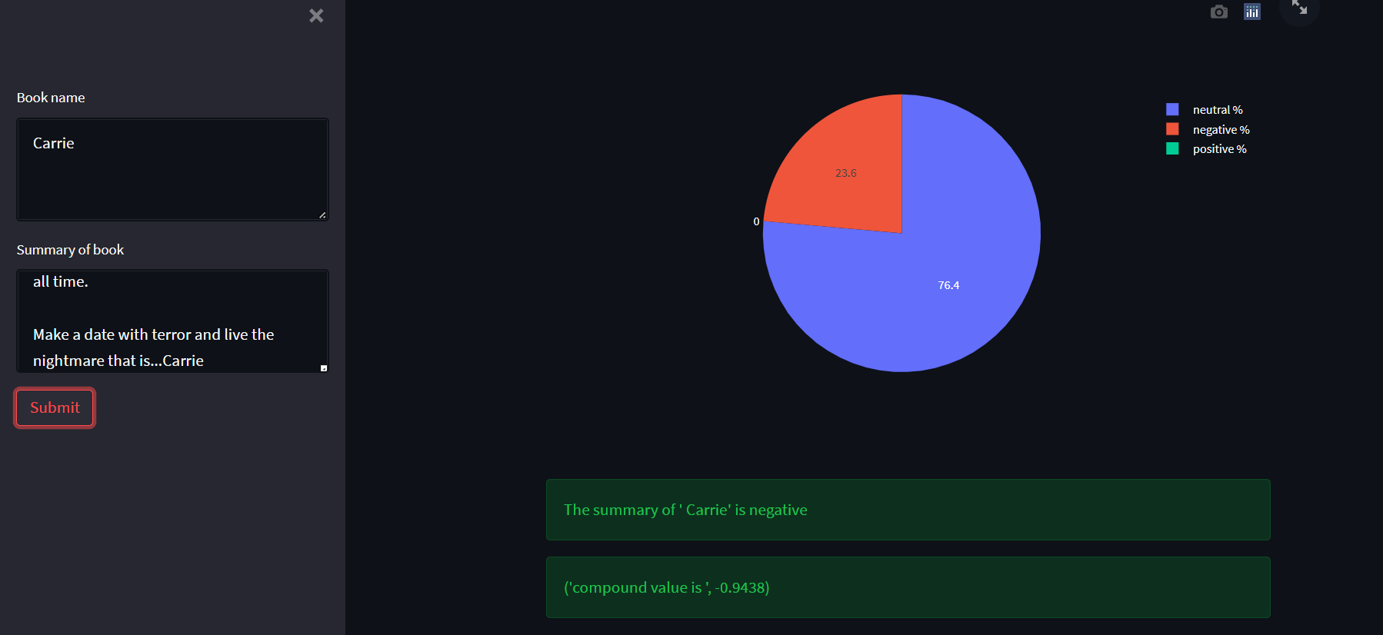
Output

Slide 22
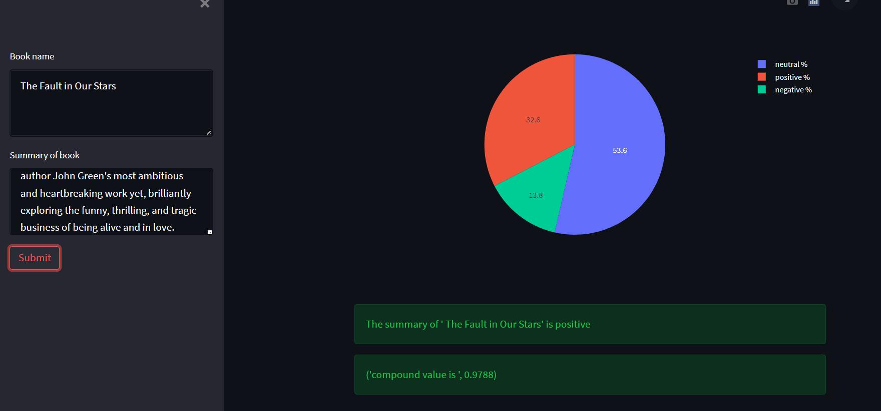
Output

Slide 23
Challenges
We were facing difficulty while deploying VADER model but after searching on internet we found the solution

